Slide 1

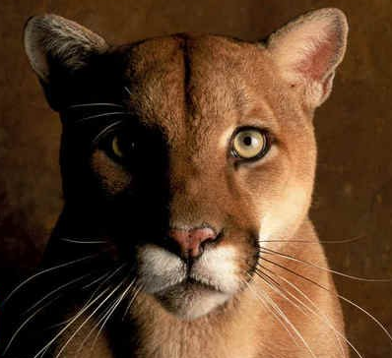

What’s underneath Houston?
Faults, salt, & sediments
Li Chang, Ph.D. Student
Advisor: Dr. Robert R. Stewart
AGL Research Presentation & Update Meeting
2nd May, 2012

Slide 2
Outline
Intro of AGL field work
Field equipment: Source, receiver and recorder system
Acquisition design and field parameter
Processing result: Fault, salt, & sediments
Summary
AGL capability & future field work

Slide 3
Field work AGL has achieved
Year | Project | Activity | Location
2009 | 1st YBRA geophysical field camp Crew and instrument built | Seismic, VSP, GPR, Well logging, Grav & Mag | Red Lodge, MT
2010 | Hockley Fault investigation | 2-D, 3-C Seismic, GPR | Cypress, TX
 | 1st UH Coast Center | 2-D, 3-C Seismic, GPR | La Marque,TX
 | Meteor crater | 2-D, 3-C Seismic, GPR, Gravity, Vmeter | Winslow, AZ
 | Geothermal | 2D seismic | James Pueblo, NM
 | 2nd YBRA geophysical field camp | Seismic, VSP, GPR, Well logging, Grav & Mag | Red Lodge, MT
 | IVI mini vibroseis training | Learn the operation | Tulsa, OK
2011 | Well perforation experiment | 3-C Seismic | Sacramento, CA
 | 3rd YBRA geophysical field camp | Seismic, VSP, GPR, Well logging, Grav & Mag | Red Lodge, MT
 | Energy Research Park | 2-C Seismic with whacker and vibe, | Houston, TX
 | Pierce Junction salt dome | 2-C Seismic , Gravity, Total station | Houston, TX
March 2012 | Hockley Fault investigation | 2-DSeismic, GPR, Gravity, Total station | Cypress, TX
 | 2nd UH Coast Center | 2-DSeismic, GPR, Gravity, Total station | La Marque,TX
 | Haiti subsurface imaging | 3-C Seismic, Gravity, Total station | Leogane, Haiti

Slide 4
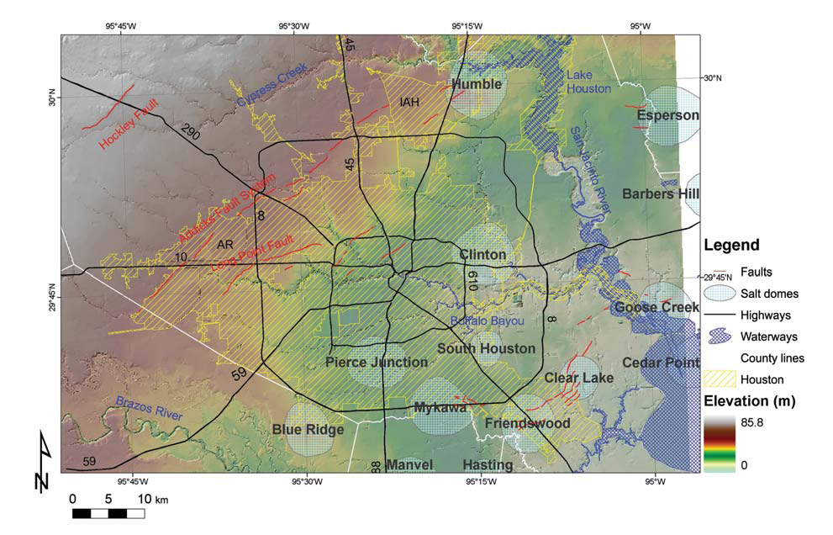
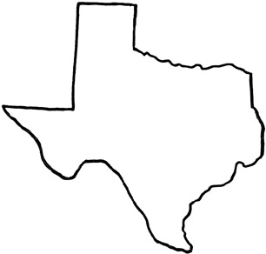
Field work done in “H” town
Hockley fault
1075 m
H
UH ERP
285 m
Pierce Junction
955 m
UH Coast center
955m
(Modified from Engelkemeir and Khan, 2007)

Slide 5
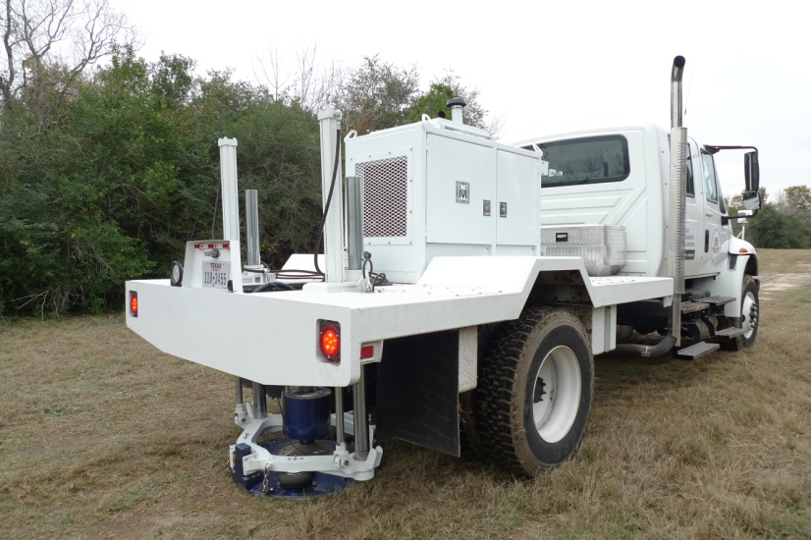
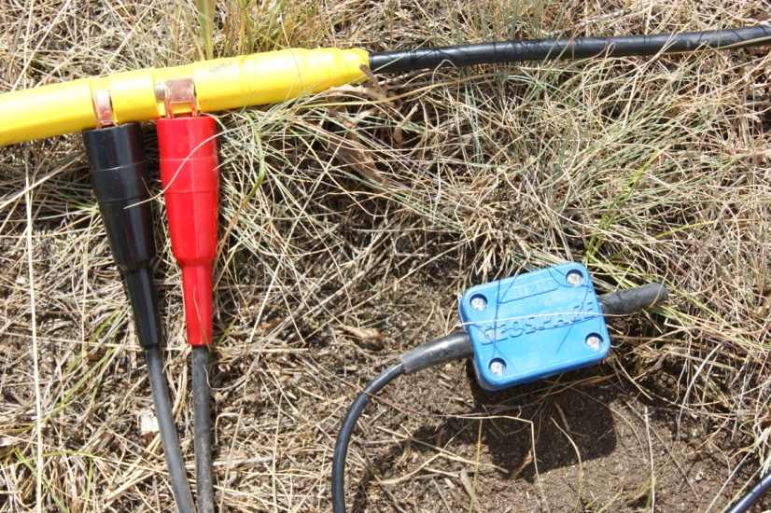
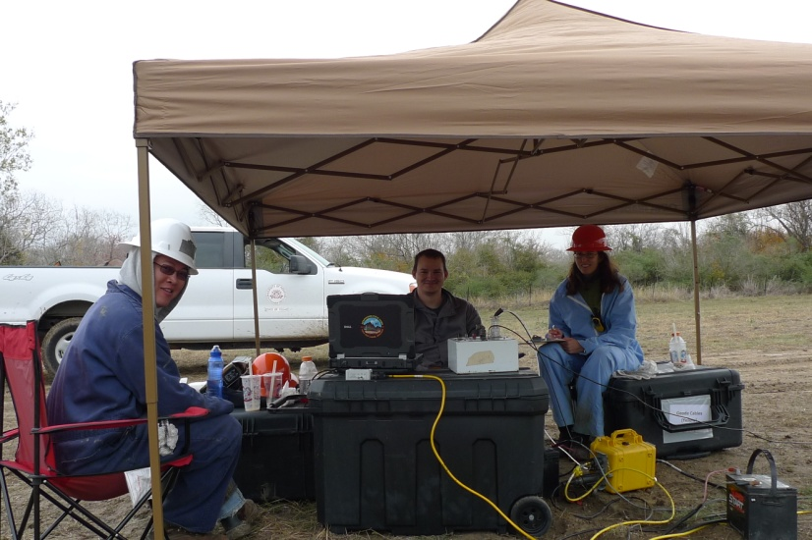
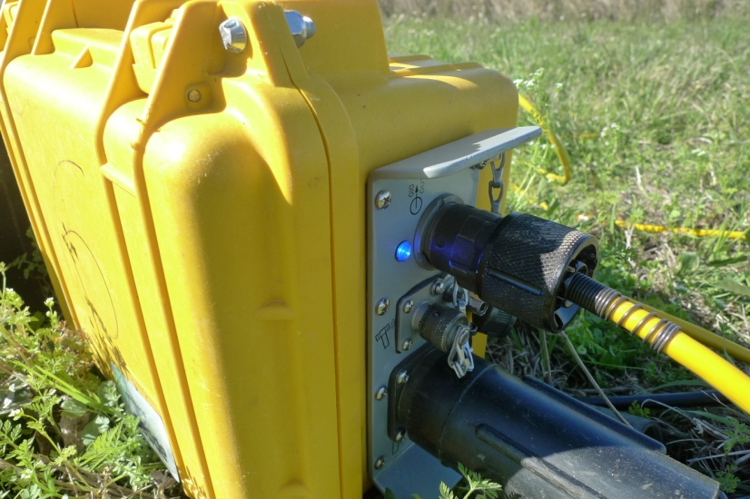
Field equipment

Slide 6
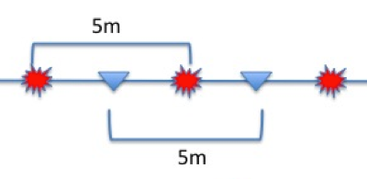
Acquisition design and field parameter
Geode
#1
Geode
#2
Geode
#9
Geode
#10
OUT
IN
OUT
IN
OUT
V
V
V
V
LOW END
LOW END
LOW END
LOW END
IN
Field parameter
Line length : 285~1075m
# of Receiver: 96~240
Shot interval : 5m, Receiver interval : 5m
Sample rate : 1ms
Record length : 4sec
Vertical Stack :2~3
Sweep length: 12sec
Sweep type : Linear sweep 10Hz ~150Hz
NIB
OUT

Slide 7
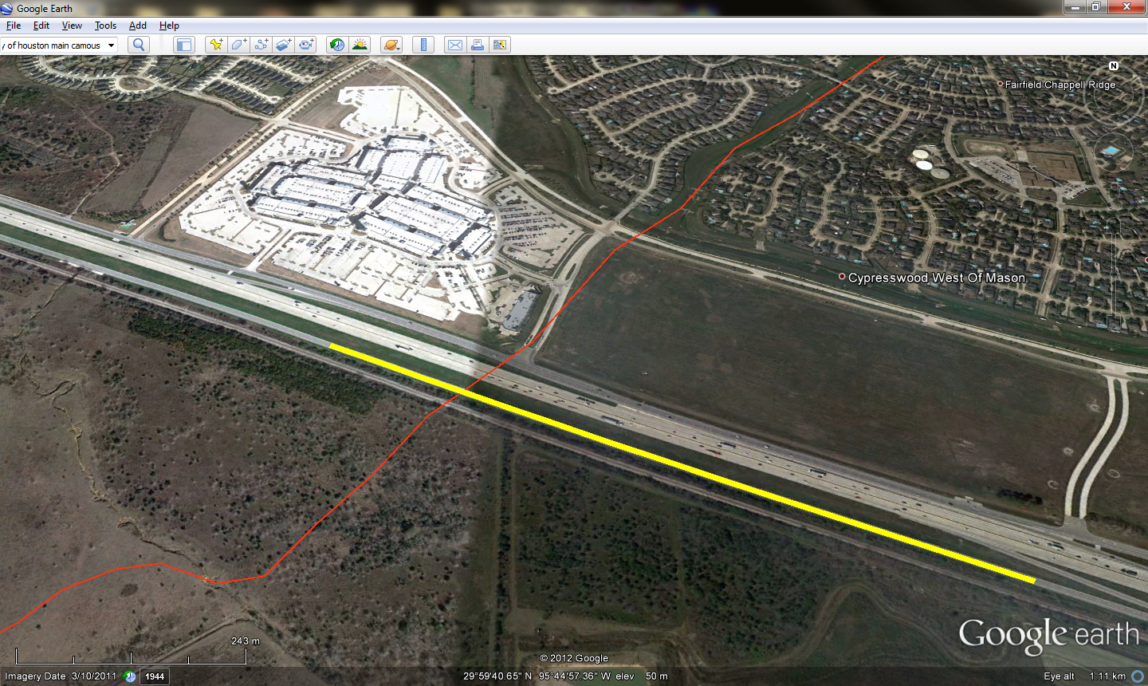
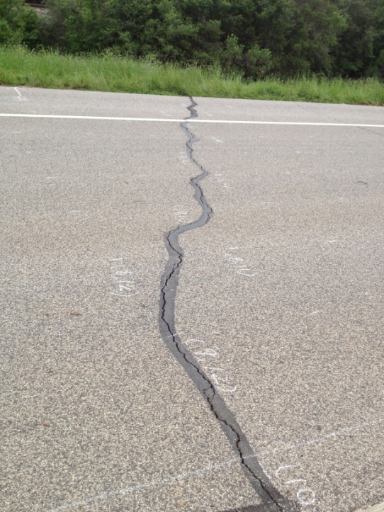
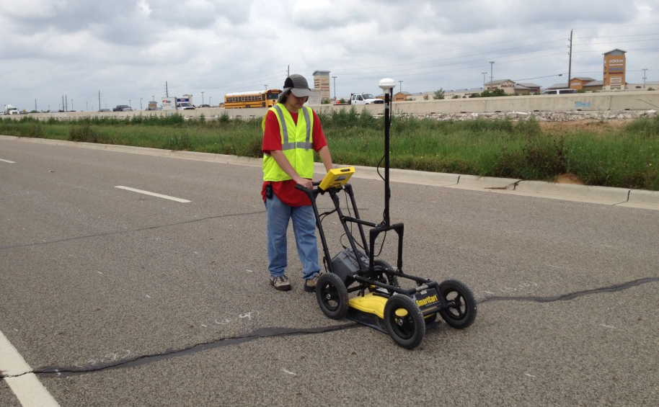
Hockley Fault
Premium Outlet
Hockley fault
dipping
Block out due to highway construction
1075m
325m+750m
Crack produced by fault?

Slide 8
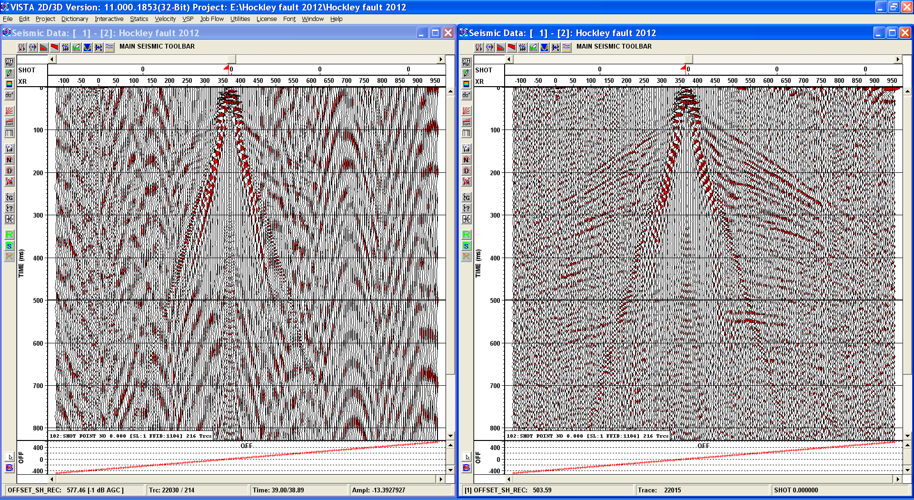
Hockley Fault
Raw shot gather
Filtered with (25-35-100-120 Hz)

Slide 9
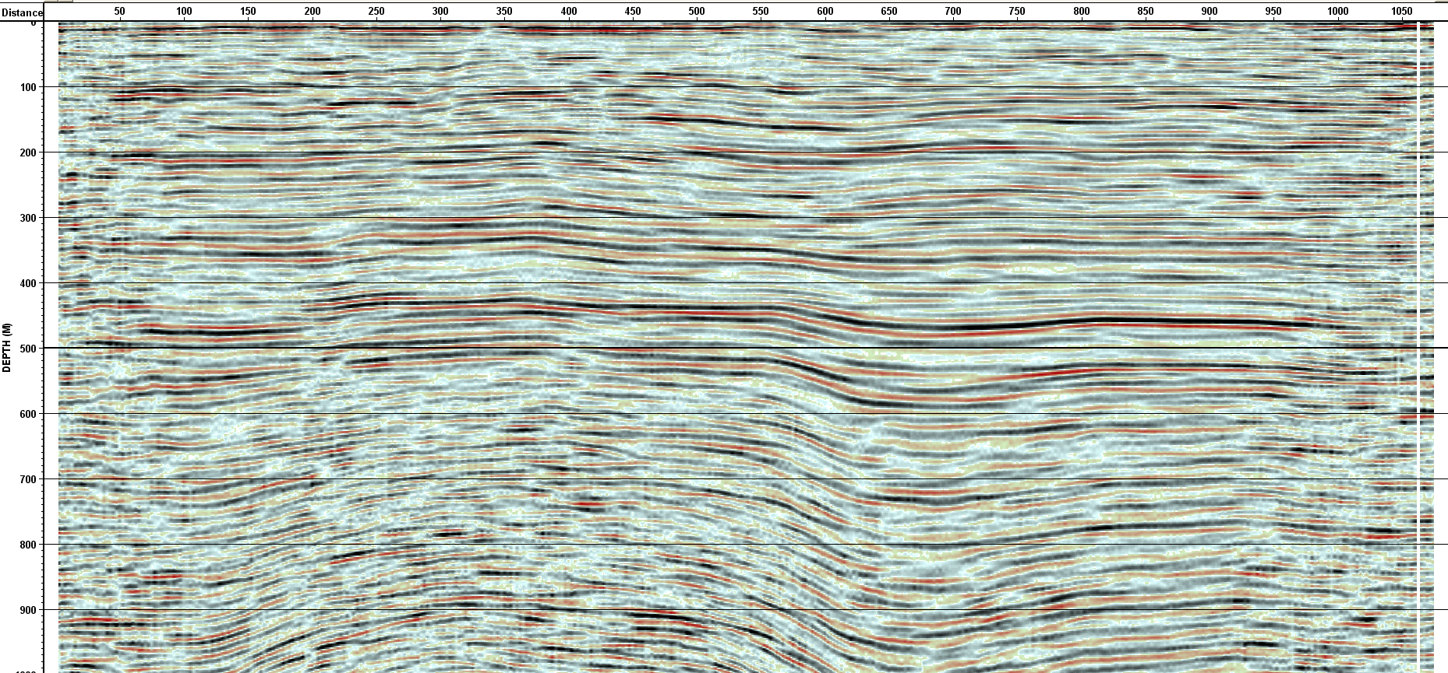
Hockley Fault
SE
200
400
600
800
1000
(m)
0 50 150 250 350 450 550 650 750 850 950 1050 (m)
Fault?
Elevation (GPS)

Slide 10
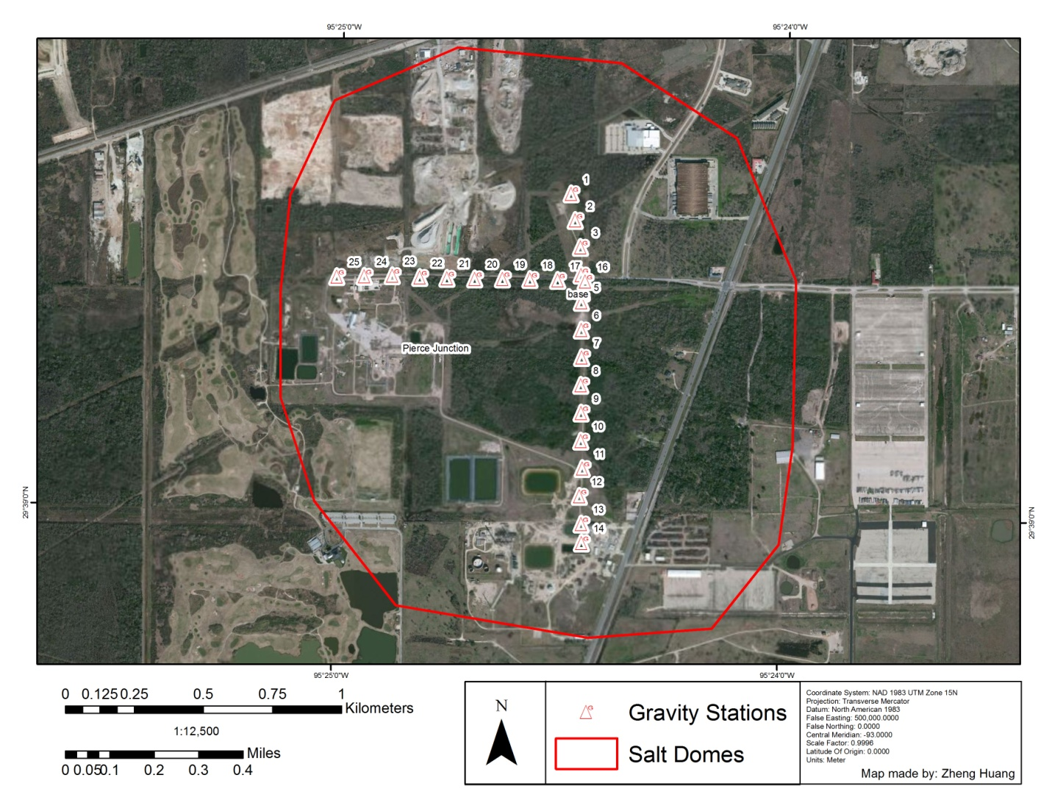
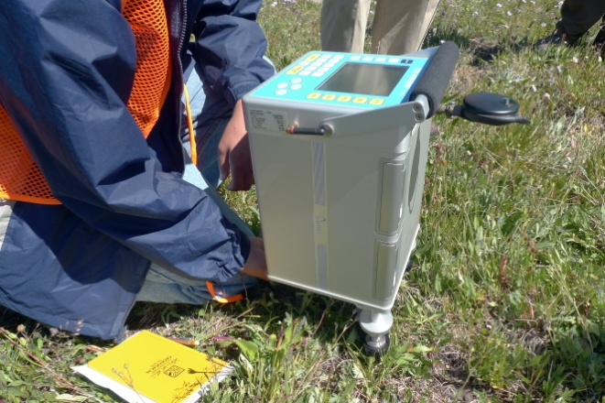
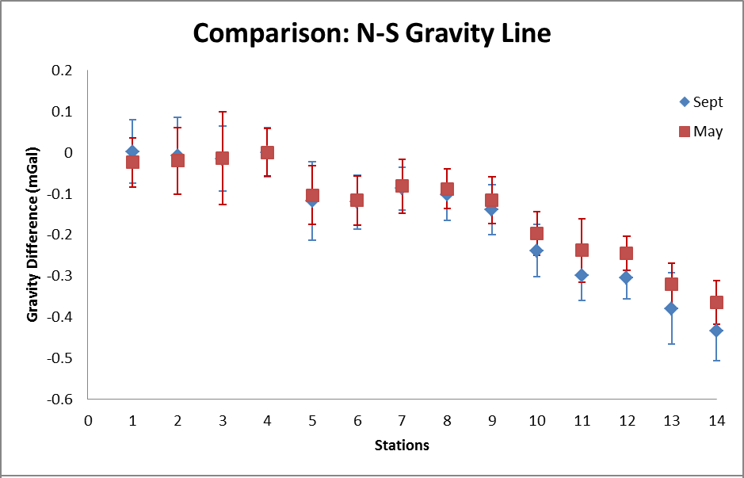
Pierce Junction salt dome

Slide 11
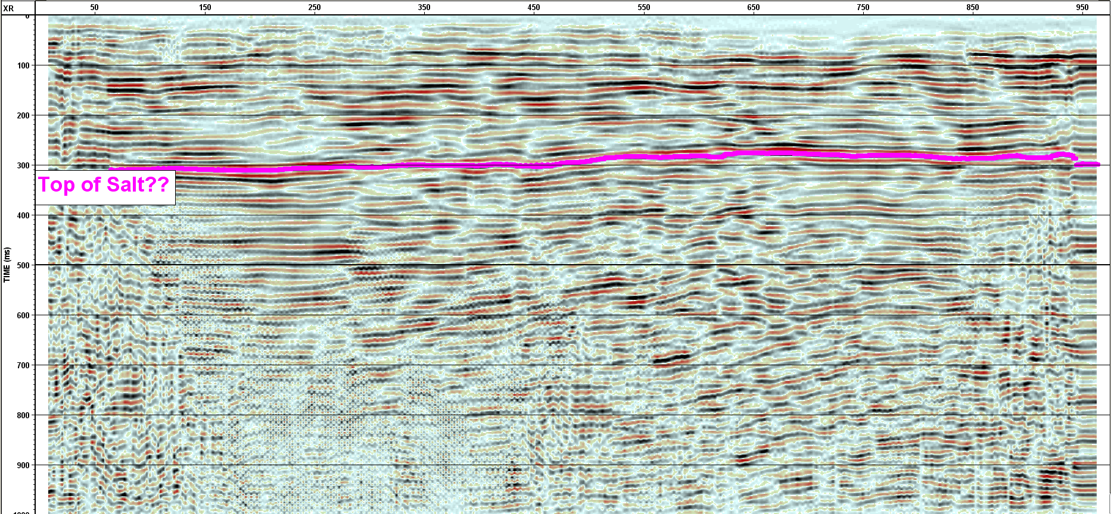
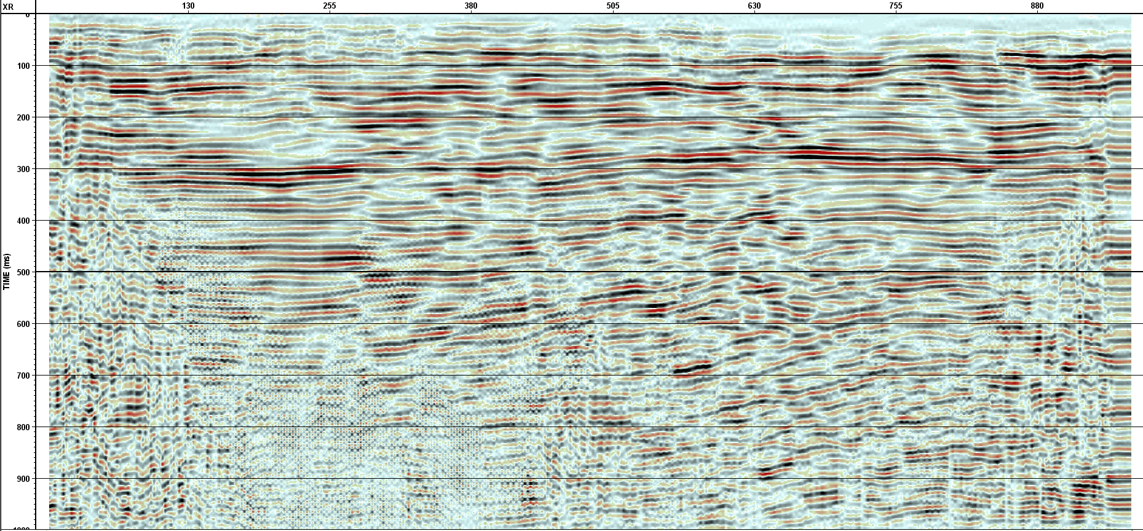
Pierce Junction salt dome
S
0 50 150 250 350 450 550 650 750 850 950 (m)
200
400
600
800
1000
(ms)

Slide 12
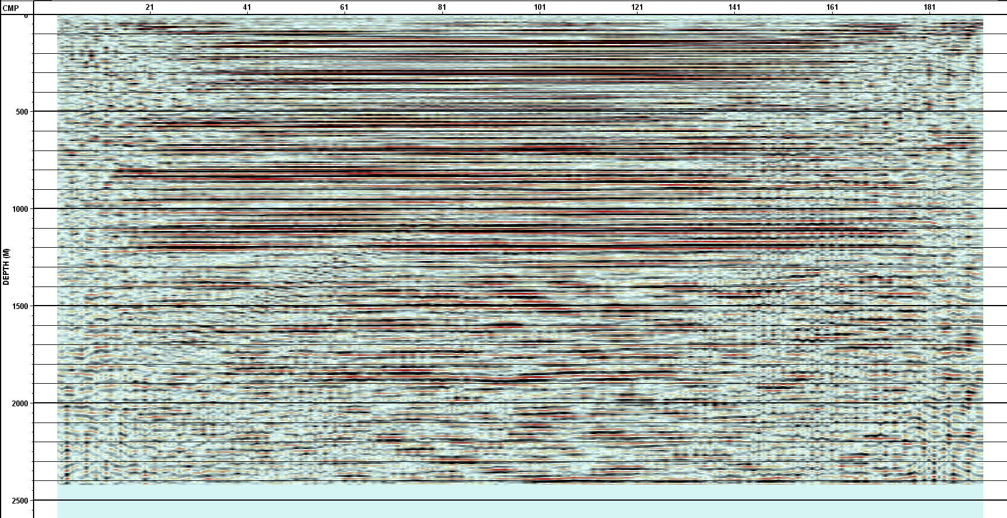
ERP-sediments
N
500
1000
1500
2000
2500 (m)
(ms)
0 30 60 90 120 150 180 210 240 270 (m)
Last credible reflector at
1900 m
(Processed by Arkadiusz Tourolski, 2011 )

Slide 13
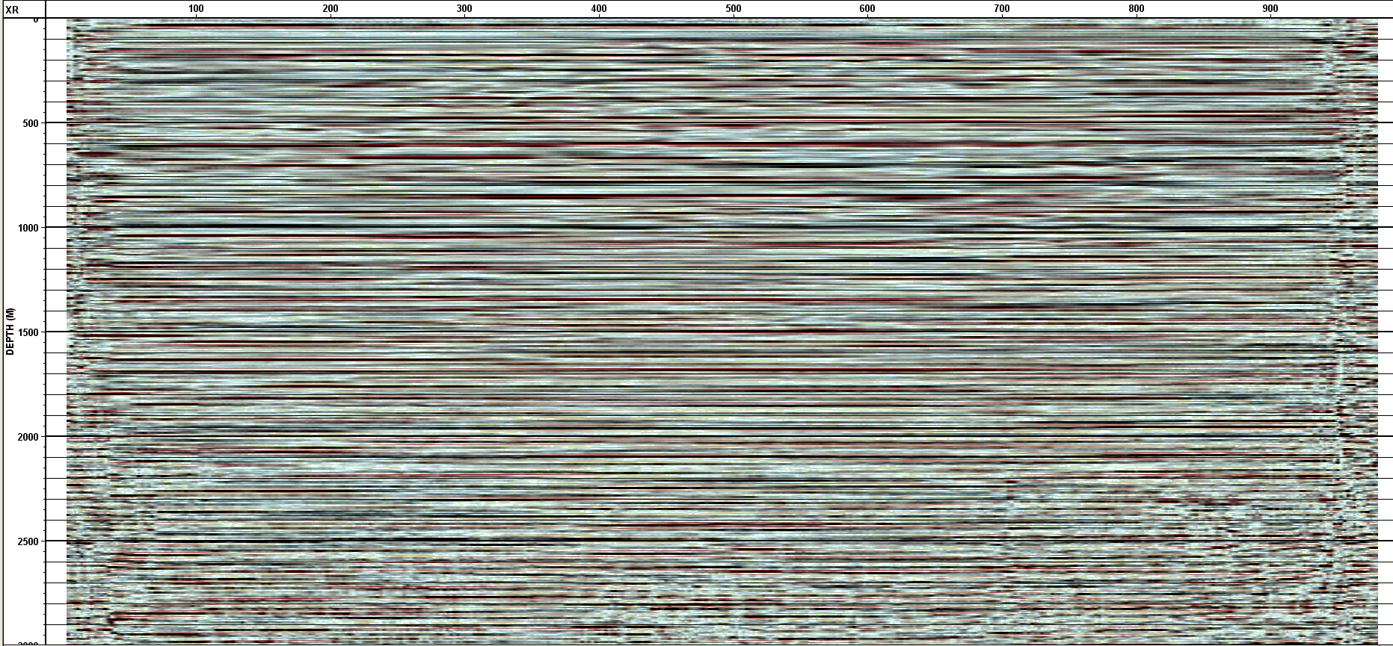
UH Coast Center-sediments
500
1000
1500
2000
2500
3000
(m)
0 100 200 300 400 500 600 700 800 900 (m)
3 times longer than ERP

Slide 14
Summary
The Hockley fault is detected and another fault dipping toward the opposite direction is also found by the processing result
The shot gather shows two strong reflectors consistently during our seismic acquisition which refers to the cap rock and top of salt at Pierce Junction salt dome
Two stack sections from UH ERP and Coast center are the representative sediments in the Houston area

Slide 15
AGL capability & future field work
Geophysical acquisition
-Well logging, VSP, Grav & Mag, GPR, 1-C & multicomponent seismic
Surveying & Measuring
- V-meter, Blasmate, Total Station and GPS
Capability
- Conduct multi-task in one time
- Shoot a 1-km seismic line in 2 days
- At least 3 software available for processing seismic data
Future work
Needvile fault investigation, Hockley fault survey in the night, well perforation and hydro-fraction experiment, seismic expedition in Utah, 4th YBRA geophysical field camp………..at least 6 for the rest of 2012

Slide 16
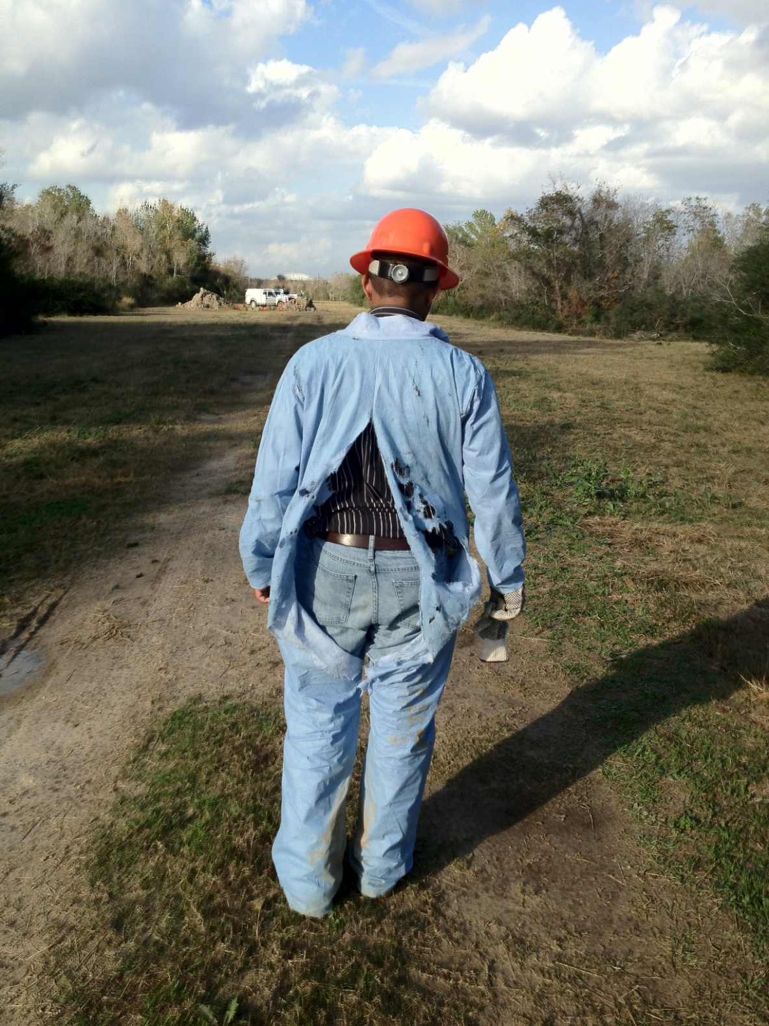
You are very welcome to join us if ……you think field work is not tough but “fun”
Special thanks to
Dr. Robert Stewart
Faculty at UH
AGL crew
Penny Maher
Laura Bell
NSM IT

